Slide 1
WELCOME
Open Enrollment presentation will begin shortly
Kimberly Nicholson John McElligatt
Heather Sartor
Open Enrollment 2025: DFT, DFSE, DSOEA, ADSA, and NCEX

Slide 2
2

Slide 3
Wellness = Saved Benefit Dollars
Get Involved
Only you can control premium rates.
Lower Claim Cost =
Great Plan Benefits
+
Lower Employee Contributions
For more information go to DSEHP.com or email
wellness@DSEHP.com
3

Slide 4
Reminder: Life Events
Reminder:
The employee is responsible that all changes are completed within 30 days of the event.
Untimely notification will make the employee ineligible to add a dependent.
If the DSEHP is not notified of dependents that should be removed from the policy, the employee can be liable for all claims and premium for the dependent that should not have had coverage.
Qualifying Household Changes
Changes in Household
Changes in Residence
Loss of Health Insurance
You must notify PlanSource by logging on to
https://benefits.plansource.com/logon or calling (888) 222-4309
within 30 days
Ways to Change Name, Address or Phone Number
Contact DPS-HR
Scan QR code at right
Visit - https://docs.google.com/forms/d/e/1FAIpQLSfQk3EZo_aqiVlkC67FSgLlVabyr-pS54aQxYS3SYcOLnXASQ/viewform?pli=1
4
Notes:
Heading? 3/7 – Reminder in writing. QR code for website, remove Le from benefit guide. Highlight the 3 – change of Health Insurance. No click3/3- Bullet point the Life Events types, add in examples.

Slide 5
Don’t Forget to Update Your Beneficiaries!
Why It’s Important
When to Review
Ensure
Ensure your loved ones are protected and the right people receive benefits.
Avoid
Avoid legal complications & delays for your beneficiaries
Reflect
Reflect Life Changes marriage, children, divorce and other events may require adjustment of beneficiaries.
During Open Enrollment:
A great time to review or make updates
Anytime:
You can update your beneficiaries at any time. Life changes happen, so adjust as needed.
Need Help?
Contact DSEHP Benefits Center
(888) 222-4309

Slide 6
Documents required for Open Enrollment
Selecting Cash in Lieu of Coverage:
Must provide documentation showing current medical ACA coverage.
Adding New Dependents to Your Plan:
Spouse - Marriage Certificate required*
Children/Stepchildren - Birth Certificate required*
*All Documents must be translated to English with a raised seal.
Ways to Find your National Provider Identifier
(NPI or PCP Code)
Scan QR Code at right
Visit https://npiregistry.cms.hhs.gov
Notes:
Add photo? Anything else?

Slide 7
Benefit Guides will be Available Online @
DSEHP.com
Effective 05-09-25
Refer to Benefit Guide for Details
7

Slide 8
DSEHP.com
Email:
support@DSEHP.com
8

Slide 9
Open Enrollment - Timeframe
April 29th through May 8th Open Enrollment meetings.
May 1st OE Postcards were mailed out.
May 5th Benefit Confirmation Statements will be emailed showing the benefits that you will have effective 07-01-25.
May 5^{th -} 19th is the period you can enroll in benefits. Enrollment can be completed by one of two ways, either by calling (888)222-4309 or Online at https://benefits.plansource.com/
May 20th Updated Benefit Confirmation Statements will be emailed to all employees to verify benefits you have enrolled for 07-01-25 through 06-30-26.
May 20^{th -} 31st is the period, if enrolled by the enrollment date, in which you can modify your benefits if you find an error while reviewing the updated Benefit Confirmation Statement. Call PlanSource at (888)222-4309 to make that change.
Eligible Members must enroll if you desire benefits for medical, dental vision, CIL or FSA on 07-01-25 through 06-30-26
“The contents of this presentation is intended for use as an easy-to-read summary only. It does not constitute a contract. Additional limitations and exclusions may apply. For an official description of benefits, please refer to each carrier’s official certificate/benefit guide.”
9

Slide 10
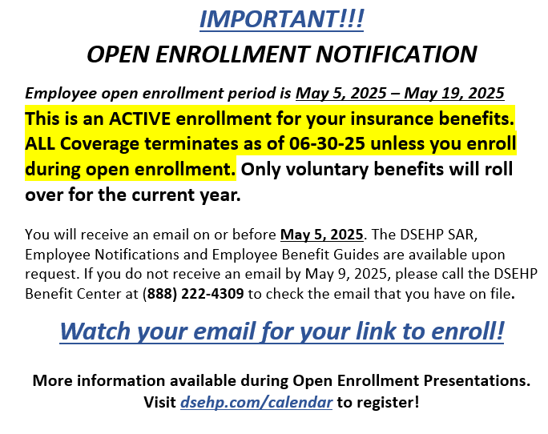
Employee Post Card
15250 Mercantile Dr.
Dearborn, MI 48120
10

Slide 11
Are there changes to the benefit designs of the plans that DSEHP will be offering?
Union Sponsored, Union Benefits
Voluntary Benefits
No Change
Age Rated
No Evidence of Insurability Required
Vision
No Change in Benefits (Dual Coverage Allowed)
Dental
No Change (Dual Coverage Allowed)
Medical
No Change (No Dual Coverage Allowed)
Cash in Lieu (CIL)
No Change
Flexible Spending Accounts (F.S.A.)
No Change (DCA=Dependent Care Account)
Update (MRA=Medical Reimbursement Account)
$3,300 Annually and a Maximum of $660 Rollover of Unused Funds
Refer to Benefit Guide for Details
11
Notes:
Need to add any Guardian updates. The top sentence, should it be reworded?

Slide 12
DSEHP Voluntary Benefits
These benefits are available to you on an optional basis. They are not employer paid and do not affect any of the employer provided benefits or your Collective Bargaining Agreement.
No EOI (Evidence of Insurability) requirement for this OE period. This means anyone that would like to purchase coverage can do so without showing how healthy they are.
Exception: Anyone previously denied by Guardian is not eligible to participate in STD or Life Insurance. However, Hospital Indemnity, Critical Illness and Accident Insurance may be purchased without EOI.
12

Slide 13
Guardian Accident Insurance
Accident Insurance
Accidents Happen. Guardian can help.
Bridging the gap between medical and non-medical expenses
Guardian Accident Insurance helps offset the costs associated with both minor and major off-the-job accidents in three important ways:
For every covered accident, Guardian pays a cash benefit payment directly to you based on covered injuries, treatments and services, regardless of what is covered by your medical plan
You decide how to use the benefits – you can use them to offset your medical plan deductibles and copays, or in any other way you choose.
Affordable, convenient payroll deductions
Plus, Guardian Accident Insurance will increase covered benefits by 20% for a child who has an accident while playing organized sports*
Accidents happen, to anyone at anytime — and could happen to you.
Over 40 million Americans received emergency room treatment for an accidental injury last year¹
Medical insurance doesn’t cover everything — recovering from an injury could cost you thousands of dollars.
Consider these facts:
The average cost of an injury from a fall is $30,000²
The average cost of an emergency room visit in the U.S. is $2,168³
Do you have enough savings to cover your share of the costs?
63% of Americans with medical insurance used all their savings for out-of-pocket medical costs⁴
How it works*
While John was hiking in a local park, he fell and tore the cartilage in his knee. He went to the hospital ER and was admitted for tests and treatment. The doctor gave him a brace and scheduled him for a follow up visit.
Ambulance: $100
Hospital Admission: $750
ER Visit: $150
Confined for 2-Day Stay: $350
MRI: $100
X-Ray: $20
Knee Cartilage Tear: $500
Knee Brace: $100
6 Follow Up Dr. Visits $150
TOTAL CASH BENEFITS $2,220
1. CDC Centers for Disease Control and Prevention, http://www.cdc.gov/nchs/fastats/hospital.htm, 2015 2. National-Safety-Council-Injury-Facts, 2013. 3. How Much Does It Cost to Go to the ER? , 2013. http://www.theatlantic.com/health/archive/2013/02/how-much-does-it-cost-to-go-to-the-er/273599/. 4. Kaiser Family Foundation and the Health Research & Educational Trust, 2015.
Notes:
Accidents happen every day, and if you and your family are active, chances are, you're no stranger to a hospital emergency room. Even with medical insurance, a fall while bicycle riding or your child's sprained ankle at soccer practice can cost you a bundle in out-of-pocket expenses.
No matter what kind of medical coverage you have, you will have out-of-pocket costs that could really set you back financially
Are you financially prepared for all of the medical and non-medical costs of treatment and recovery from a serious injury?

Slide 14
Critical Illness Insurance
Financial protection to help you focus on what matters
Benefit Plan Overview
Employee Benefit | Choose From 2 Options: $5,000 or $10,000
Spouse Benefit | 50% of Employee Benefit, up to $5,000
Child(ren) Benefit, up to age 26 | 25% of Employee Benefit, up to $2,500
Portability Privileges | Included
Pre-Existing Condition Limitation | 3 Month Look-back Period for 1st 12 Months on Plan
Evidence of Insurability (EOI) | New This Year: All Amounts Guarantee Issue During Annual Enrollment
Wellness Benefit - $50 Per Year | Included for Employee, Spouse & Child
Illnesses can you cost thousands you of dollars — even with medical insurance.
Every minute of each day, an American becomes seriously ill¹
More than 5.7 million patients are admitted annually to intensive care units (ICUs) in the United States²
Are you financially prepared to cover the out-of-pocket costs and other expenses?
Average out-of-pocket expenses for illnesses can be up to $5,000 per year³
63% of Americans with medical insurance lost all their savings to out-of-pocket medical costs⁴
The out-of-pocket costs to treat a serious illness is the primary cause of personal bankruptcies for Americans — even with medical insurance!⁵
Worry less about how to pay your illness-related expenses and concentrate more on your recovery.
Cash benefits are paid directly to you based on each covered diagnosis, no matter what type of medical insurance plan you have
You decide how to use the benefits
Affordable, convenient payroll deductions
Take the coverage with you if you leave your current employer
14
1. Google Consumer Survey for personal finance website GOBankingRates.com, 2015. 2. Society of Critical Care Medicine. http://www.sccm.org/Communications/Pages/CriticalCareStats.aspx.
3 . http://www.bankrate.com/finance/insurance/coping-with-out-of-pocket-health-care-cost-1.aspx. 4 . Kaiser Family Foundation and the Health Research & Educational Trust, 2015.
5 . NerdWallet Health, 2013 , https://www.nerdwallet.com/blog/health/medical-bankruptcy/.
Notes:
Guardian helps protect your savings
Guardian Critical Illness Insurance supplements your medical plan— no matter what type of other coverage you have
Guardian pays you cash benefits based on each eligible diagnosis
The cash benefits are paid directly to you — you decide how to use them

Slide 15
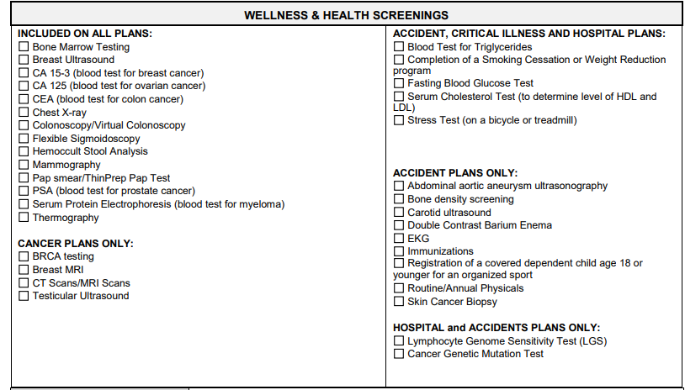
WELLNESS CREDIT
(For Critical Illness & Accident Coverage)
Chest X-Ray
Cholesterol Test
Colonoscopy
Mammography
Pap Smear
PSA (blood test)
Stress Test
Notes:
Per KN Wellness Credit – Highlight test needed

Slide 16
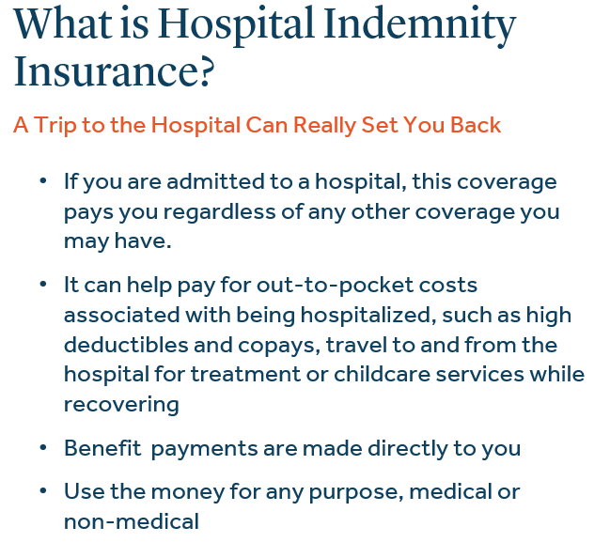
Hospital Indemnity Insurance
Benefit Overview
Hospital/ICU Admission | $500/$1,000 per admission, limited to 1 admission(s) per insured.
Hospital/ICU Confinement | $100/$200 per day, limited to 15 day(s) per insured per benefit year.
Portability | Included
Child(ren) Age Limits | Children age birth to 26 years

Slide 17
Guardian Disability Insurance
Short-Term Disability Insurance
Provide a financial safety net for yourself and those who depend on you
Benefit Plan Overview
Coverage amount | Flat Weekly Options Ranging from $200 to $750 per Week
Maximum Payment Period | 26 weeks
Accident Benefits Begin Illness Benefits Begin | Day 1 Day 8
Pre-Existing Condition Limitation | Benefits Limited to 2 Weeks for Pre-Existing Conditions 3 Month Look-back Period for 1st 12 Months on Plan
Evidence of Insurability (EOI) | New This Year: All Amounts Guarantee Issue During Annual Enrollment
If you or family depend on your income, you should consider Short Term Disability coverage…
Replaces a portion of your income if you become seriously ill or injured
Affordable, convenient payroll deductions
Extensive resources and support, to help you get back to work and a productive life.
Fast claims payments
You might underestimate your risk of a disabling illness or injury
Over 50% of disabled Americans are between ages 18 – 64¹
95% of disabilities are not covered by Workman’s Compensation plans¹
50% of Americans would have financial difficulties within a month of being disabled, and one in four would have problems immediately²
Council for Disability Awareness, 2015 http://www.disabilitycanhappen.org/chances_disability/
Life Happens study, 2015.
Notes:
Protect your paycheck if you are unable to work.
Your income is one of your most valuable assets
No one plans on becoming disabled, but a serious illness or injury can strike anyone at any time, and at any age, taking away your ability to earn a paycheck. Nearly 25% of Americans will become disabled before they retire¹, so this could happen to you. And disabilities can result not just from accidents, but illnesses such as heart attack, cancer, and stroke.
How long can you live on your savings if you became disabled?

Slide 18
Voluntary Life Insurance
Keep your family and finances safe
Benefit Plan Overview
Employee Benefit | 8 Options from $5,000 to $150,000
Spouse Benefit | 50% of Employee Benefit, up to $25,000
Child(ren) Benefit, up to age 26 | 10% of Employee Benefit, up to $10,000
Portability & Conversion | Included
Evidence of Insurability (EOI) | New This Year: All Amounts Guarantee Issue During Annual Enrollment
x
5 to 7 years
Annual Salary
Life insurance is not just about final expenses.
50% of US households would suffer significant financial impact from the loss of their primary wage earner¹
Life insurance is for the people who depend on you.
How will your dependents cover the following expenses?
Can you afford not to have life insurance?
It can take 5 years to 7 years to financially recover from the loss of an income earner.¹
A general guideline is to have coverage equal to 5 to 7 times your annual salary:
Provides a benefit to help pay expenses and provide financial security for those who depend on you.
Three unique benefits only life insurance provides:
Paid directly to your beneficiaries
Generally, not subject to income taxes
The value is not affected by market conditions
Flexible coverage that you can update as your life changes
Mortgage / rent Auto payments Education/College | Childcare Assistance Legal or Medical Fees Outstanding Debts
Free Online WillPrep Services
Included for All Voluntary Life Members!
1. LIMRA's Facts About Group Life (2015)
Policy Amount
Notes:
Why?
1. If the unexpected happens
Dying suddenly — in an accident, by unexpected illness or even of natural causes — can happen at any time. Life insurance helps your loved ones pay the mortgage, bills, even college costs, after you’re gone. It also provides tax-free cash to pay estate and death duties. Nothing can replace you in their hearts, but planning ahead with life insurance can make things easier for those you leave behind.
2. Funerals are expensive.
In some cases, upwards of $7,000 to $10,000 — and we’re not talking about extravagant funeral services. This is the average cost of a burial ceremony that will be faced by your loved ones. At an already difficult and emotional time, your life insurance can cover these expenses without financial hardship or further stress.
3. Protect those you love.
In your life, you work hard to make sure those you love — spouse, partner, children, family members — are taken care of. It’s just as important to consider providing financial support for the future living costs of surviving dependents. After all, they will have to go on without you. Make sure they’re protected, too.
4. Death shouldn’t mean debt.
Life Insurance can help your dependents cover any financial responsibilities that are left after your death. Debt can be a tremendous burden, on top of the already emotional toll your absence creates in their lives.
You may be healthy today, but if your health changes, you may not qualify to purchase life insurance in the future.
Bottom line, if there are people who depend on you, then you should consider life insurance coverage.
Will your family have the financial security they need over time?

Slide 19
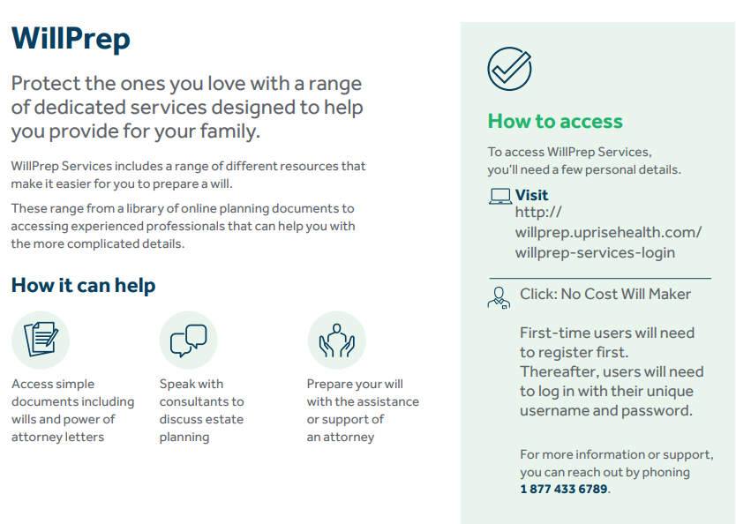

Slide 20
Vision
Carrier: NVA
Remember that you can have coordination of benefits for vision.
If your spouse works for the district, you can both have vision benefits
Any remaining balance can be invoiced to the secondary policy
“The contents of this presentation is intended for use as an easy-to-read summary only. It does not constitute a contract. Additional limitations and exclusions may apply. For an official description of benefits, please refer to each carrier’s official certificate/benefit guide.”
20

Slide 21
Dental
Carrier: Delta Dental
Benefits:
Network – Delta Premier and Delta PPO
Class One
Diagnostic & Preventative Services
100% payment for PPO Provider – No balance billing allowed for PPO doctor.
Class Two
Basic Services
80% payment for PPO Provider
Class Three
Major Services
60% payment for PPO Doctor
Annual Maximum Class 1, 2 & 3 is $2,500
Class Four
Orthodontic Services
50% Payment for PPO Provider
Orthodontic Age Limit is through age 18 and under
Lifetime Maximum Class 4 is $1,500
Remember that you can have coordination of benefits for dental.
If your spouse works for the district, you can both have dental benefits
Any remaining balance can be invoiced to the secondary policy
“The contents of this presentation is intended for use as an easy-to-read summary only. It does not constitute a contract. Additional limitations and exclusions may apply. For an official description of benefits, please refer to each carrier’s official certificate/benefit guide.”
21
Notes:
Photo was taken from online stock photo option. When it was added it added some licensing verbiage. Not sure if it has to stay on there or not.

Slide 22
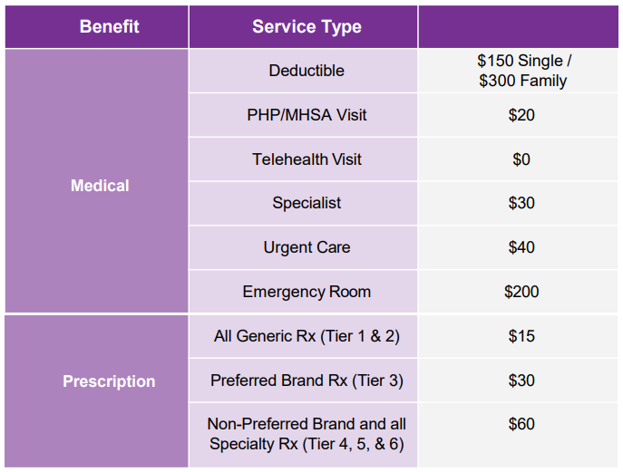
Quick Reference of Medical Plan Design
“The contents of this presentation is intended for use as an easy-to-read summary only. It does not constitute a contract. Additional limitations and exclusions may apply. For an official description of benefits, please refer to each carrier’s official certificate/benefit guide.”
22
Notes:
Help… can’t remove the space

Slide 23
Deductible - REMINDER
Calendar Year Deductible – How does it work?
January 1, 2025, to December 31, 2025
Deductible Started Over
Single Deductible $150.00
Two Person/Family $300.00
January 1, 2026, to December 31, 2026
(if no plan changes)
Deductible Starts Over
Single Deductible $150.00
Two Person/Family $300.00
23

Slide 24
Cash in Lieu
Cash in Lieu | 2024-25 | 2025-26
Annual | $880-$2,200 | $880-$2,200
 | Payable over 20 pays (Beginning last payroll in September - June) | Payable over 20 pays (Beginning last payroll in September - June)
Single | $44.00 Per Pay | $44.00 Per Pay
Two Person | $88.00 Per Pay | $88.00 Per Pay
Family | $110.00 Per Pay | $110.00 Per Pay
Eligibility Requirements
If your spouse works in the district, you will not qualify for this benefit.
If your employee FTE (profile is less than 1.0) you will not qualify for this benefit.
This is only offered to those who purchase their insurance benefits outside of the district.
Proof of other ACA approved insurance is mandated before approval.
24

Slide 25
Flexible Spending Accounts
What types of F.S.A. accounts are available?
Medical Reimbursement Account
Maximum $3,300
Rollover Maximum $660
Dependent Care Account
$2,500 per child, maximum $5,000 per family
No claims paid until payroll deductions have been received
No Rollover
Why would I want a F.S.A. account?
Allows you to save money tax free on known expenses such as:
Ortho
Childcare
What happens if I do not use it all?
$660 can rollover for Medical Reimbursement Account only if you enroll in the July 2025-June 2026 year with at least $20 to hold the account open for the funds to roll over.
No rollover allowed on dependent care account
Government Guidebook
irs.gov/publications/p502
25
Notes:
2/7 - the new maximum for FSA will be $3300, with a max rollover of $660

Slide 26
Dependent Care Flexible Spending Account
Annual Maximum per Family: $5,000 (IRS Sets Limits Annually)
• Allows you to set aside pretax dollars to pay for dependent care expenses such as day care and day camp to allow you
to work
• Expenses related to children under the age of 13
• Other family members such as disabled children or elderly parents who are unable to care for themselves and for whom you claim as Dependents on your tax return may also be eligible
• Overnight stays are not covered
• Plan before making elections
• At the time of enrollment, you make your decision on your contribution amount for the entire plan year
• Funds remaining in your Dependent Care account at time of employment termination or year end will be forfeited
How it works
Example:
John elects to contribute $5000 for the Dependent Care FSA plan year that starts on January 1.
John’s employer has 20 pay periods in one year. John will see a pre-tax deduction in each paycheck of $250.00
John’s son is enrolled in a licensed day care center while he is at work at a cost of $100 per week.
John’s son attends the day care center the first week in January; John is not able to use his Dependent Care FSA account until his first paycheck in January with his $192.30 deduction.
John can receive reimbursement for his eligible out of pocket costs as long as there are funds available in his account.
26
Notes:
John and Kim are going to update highlighted section to reflect 20 pays and DSEHP enrollment dates.

Slide 27
EAP - Employee Assistance Program
Need Support-call the Ulliance EAP program offered by the district at (800)448-8326
27

Slide 28
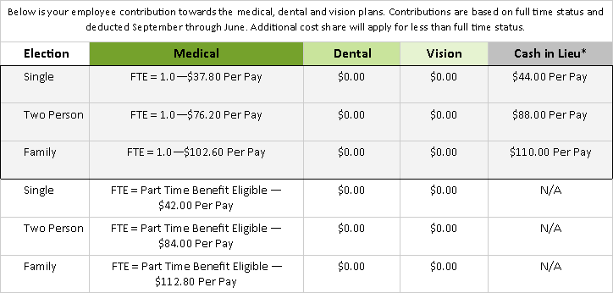
Employee Contributions – Per Pay
*
To receive Cash in Lieu you will be required to show proof of other coverage on an annual basis and have an FTE profile of 1.0 and your spouse does not work in the district.
28

Slide 29
VERIFY * VERIFY * VERIFY
REMEMBER TO REVIEW BENEFIT CONFIRMATION STATEMENTS SENT TO YOU ON MAY 5, 2025, THEN ENROLL.
ANYONE THAT HAS NOT ENROLLED BY 05-19-2025 WILL HAVE THEMSELVES AND ANY DEPENDENTS CANCELLED FOR MEDICAL, DENTAL AND VISION INSURANCE EFFECTIVE 07-01-25 THROUGH
06-30-26, UNLESS THEY HAVE A QUALIFYING LIFE EVENT.
THE DSEHP CANNOT BE RESPONSIBLE FOR MISSING DEPENDENTS OR COVERAGE.
ONLY YOU ARE.
29

Slide 30
30

Slide 31
The intent of this presentation is to provide you with general information regarding the status of, and/or potential concerns related to, your current employee benefits environment. It does not necessarily fully address all your specific issues. It should not be construed as, nor is it intended to provide, legal advice. Questions regarding specific issues should be addressed by your general counsel or an attorney who specializes in this practice area.
31

Slide 32
Q&A
Email:
support@DSEHP.com
32

