Slide 1
WELCOME
Open Enrollment presentation will begin shortly
Kimberly Nicholson John McElligatt
Open Enrollment 2025: Adult Education

Slide 2
2

Slide 3
Wellness = Saved Benefit Dollars
Get Involved
Only you can control premium rates.
Lower Claim Cost =
Great Plan Benefits
+
Lower Employee Contributions
For more information go to DSEHP.com or email
wellness@DSEHP.com
3

Slide 4
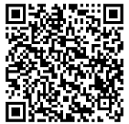
Reminder: Life Events
Reminder:
The employee is responsible that all changes are completed within 30 days of the event.
Untimely notification will make the employee ineligible to add a dependent.
If the DSEHP is not notified of dependents that should be removed from the policy, the employee can be liable for all claims and premium for the dependent that should not have had coverage.
Qualifying Household Changes
Changes in Household
Changes in Residence
Loss of Health Insurance
You must notify PlanSource by logging on to
https://benefits.plansource.com/logon or calling (888) 222-4309
within 30 days
Ways to Change Name, Address or Phone Number
Contact DPS-HR
Scan QR code at right
Visit - https://docs.google.com/forms/d/e/1FAIpQLSfQk3EZo_aqiVlkC67FSgLlVabyr-pS54aQxYS3SYcOLnXASQ/viewform?pli=1
4
Notes:
Heading? 3/7 – Reminder in writing. QR code for website, remove Le from benefit guide. Highlight the 3 – change of Health Insurance. No click3/3- Bullet point the Life Events types, add in examples.

Slide 5
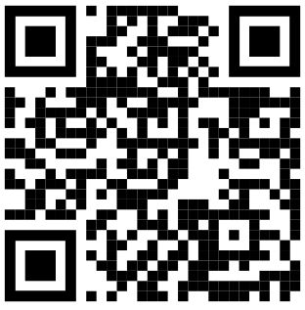
Documents required for Open Enrollment
Adding New Dependents to Your Plan:
Spouse - Marriage Certificate required*
Children/Stepchildren - Birth Certificate required*
*All Documents must be translated to English with a raised seal.
Ways to Find your National Provider Identifier
(NPI or PCP Code)
Scan QR Code at right
Visit https://npiregistry.cms.hhs.gov
Notes:
Add photo? Anything else?

Slide 6
Benefit Guides will be Available Online @
DSEHP.com
Effective 05-09-25
Refer to Benefit Guide for Details
6

Slide 7
DSEHP.com
Email:
support@DSEHP.com
7

Slide 8
Open Enrollment - Timeframe
April 29th through May 8th Open Enrollment meetings.
May 1st OE Postcards were mailed out.
May 5th Benefit Confirmation Statements will be emailed showing the benefits that you will have effective 07-01-25.
May 5^{th -} 19th is the period you can enroll in benefits. Enrollment can be completed by one of two ways, either by calling (888)222-4309 or Online at https://benefits.plansource.com/
May 20th Updated Benefit Confirmation Statements will be emailed to all employees to verify benefits you have enrolled for 07-01-25 through 06-30-26.
May 20^{th -} 31st is the period, if enrolled by the enrollment date, in which you can modify your benefits if you find an error while reviewing the updated Benefit Confirmation Statement. Call PlanSource at (888)222-4309 to make that change.
Eligible Members must enroll if you desire benefits for medical benefits for 07-01-25 through 06-30-26
“The contents of this presentation is intended for use as an easy-to-read summary only. It does not constitute a contract. Additional limitations and exclusions may apply. For an official description of benefits, please refer to each carrier’s official certificate/benefit guide.”
8

Slide 9
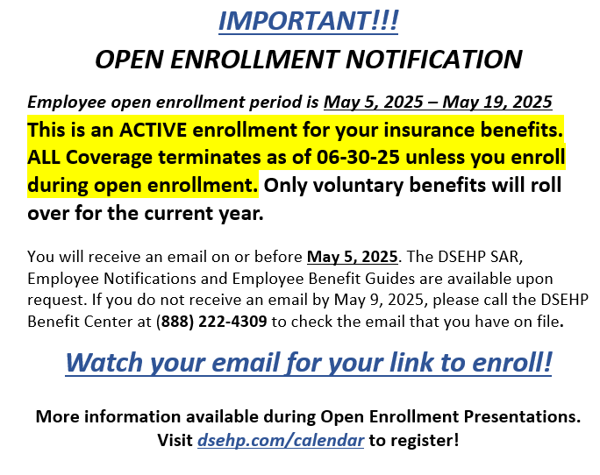
Employee Post Card
15250 Mercantile Dr.
Dearborn, MI 48120
9

Slide 10
Are there changes to the benefit designs of the plans that DSEHP will be offering?
Union Sponsored, Union Benefits
Medical
No Change (No Dual Coverage Allowed)
Refer to Benefit Guide for Details
10
Notes:
Need to add any Guardian updates. The top sentence, should it be reworded?

Slide 11
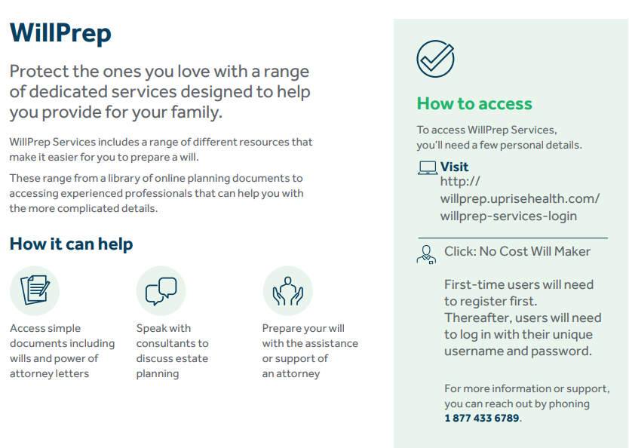

Slide 12
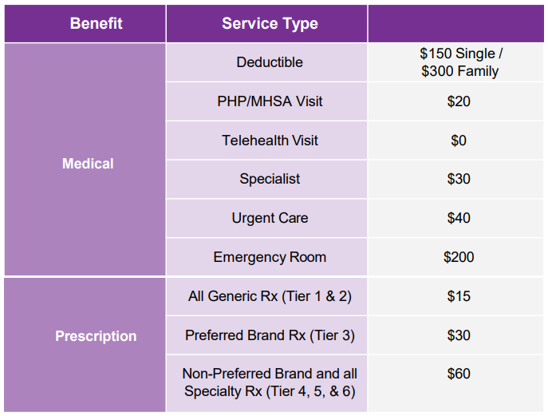
Quick Reference of Medical Plan Design
“The contents of this presentation is intended for use as an easy-to-read summary only. It does not constitute a contract. Additional limitations and exclusions may apply. For an official description of benefits, please refer to each carrier’s official certificate/benefit guide.”
12
Notes:
Help… can’t remove the space

Slide 13
Deductible - REMINDER
Calendar Year Deductible – How does it work?
January 1, 2025, to December 31, 2025
Deductible Started Over
Single Deductible $150.00
Two Person/Family $300.00
January 1, 2026, to December 31, 2026
(if no plan changes)
Deductible Starts Over
Single Deductible $150.00
Two Person/Family $300.00
13

Slide 14
EAP - Employee Assistance Program
Need Support-call the Ulliance EAP program offered by the district at (800)448-8326
14

Slide 15
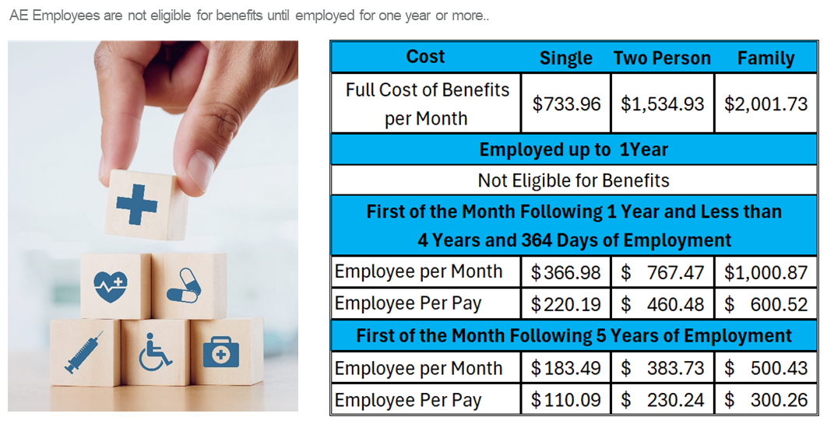
Employee Contributions – Per Pay
15

Slide 16
VERIFY * VERIFY * VERIFY
REMEMBER TO REVIEW BENEFIT CONFIRMATION STATEMENTS SENT TO YOU ON MAY 5, 2025, THEN ENROLL.
ANYONE THAT HAS NOT ENROLLED BY 05-19-2025 WILL HAVE THEMSELVES AND ANY DEPENDENTS CANCELLED FOR MEDICAL INSURANCE EFFECTIVE 07-01-25 THROUGH
06-30-26, UNLESS THEY HAVE A QUALIFYING LIFE EVENT.
THE DSEHP CANNOT BE RESPONSIBLE FOR MISSING DEPENDENTS OR COVERAGE.
ONLY YOU ARE.
16

Slide 17
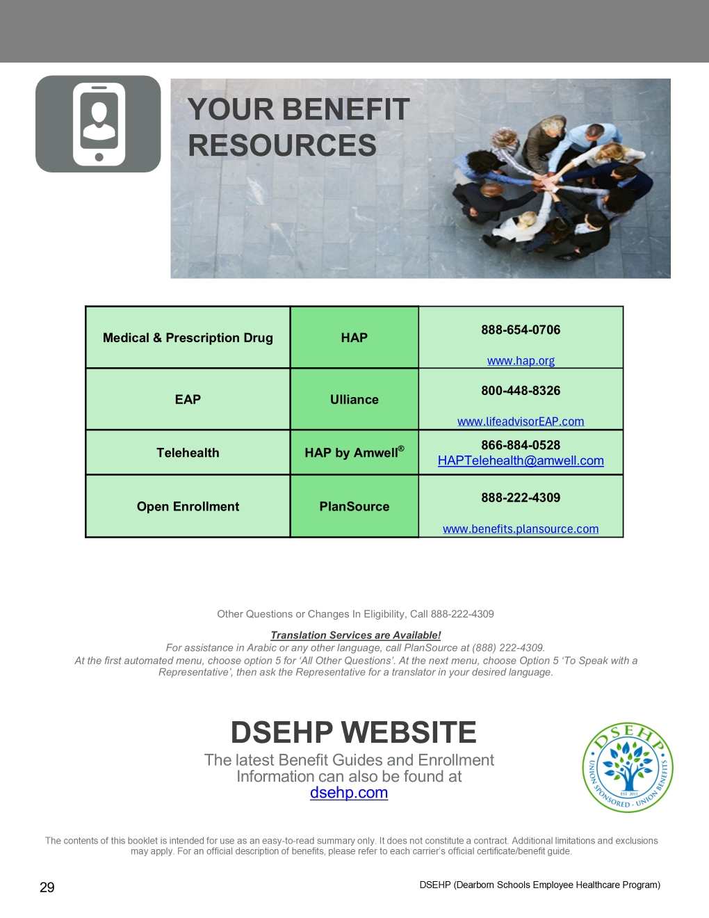
17

Slide 18
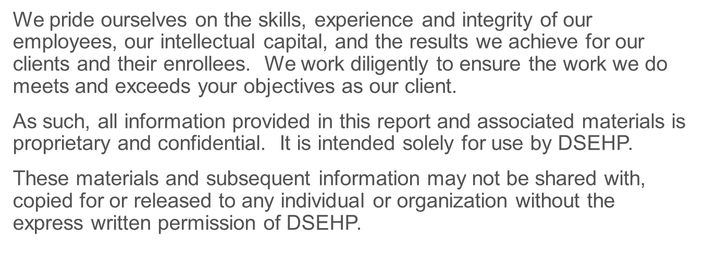
The intent of this presentation is to provide you with general information regarding the status of, and/or potential concerns related to, your current employee benefits environment. It does not necessarily fully address all your specific issues. It should not be construed as, nor is it intended to provide, legal advice. Questions regarding specific issues should be addressed by your general counsel or an attorney who specializes in this practice area.
18

Slide 19
Q&A
Email:
support@DSEHP.com
19

